Slide 1





UNOX

Slide 2


AGENDA
GOALS
PROJECT INTRODUCTION
DELIVERY LANDSCAPE
ER DIAGRAM
DATA DICTIONARY
DATA GENERATION
PRODUCT BACKLOG
DATA ANALYTICS

Slide 3

GOALS
Designing Efficient Database and Structure for UNOX
Analytics and Reporting for Business Insights
Data Integrity.
Optimized Query Performance and Scalability

Slide 4

PROJECT INTRODUCTION
UNOX is a comprehensive online ticket booking solution designed to enhance the customer experience for multiplex cinemas.
It seamlessly integrates movie bookings, secure payment processing, food orders, and loyalty programs, while also providing features like QR code-based entry and real-time transaction tracking.
Its scalable and secure architecture, UNOX ensures a smooth and efficient booking process, both online and at the cinema.

Slide 5

DELIVERY LANDSCAPE
Entities
Attributes
Relationships
ER Diagram
Data Dictionary
Data Generation
Data Visualization

Slide 6

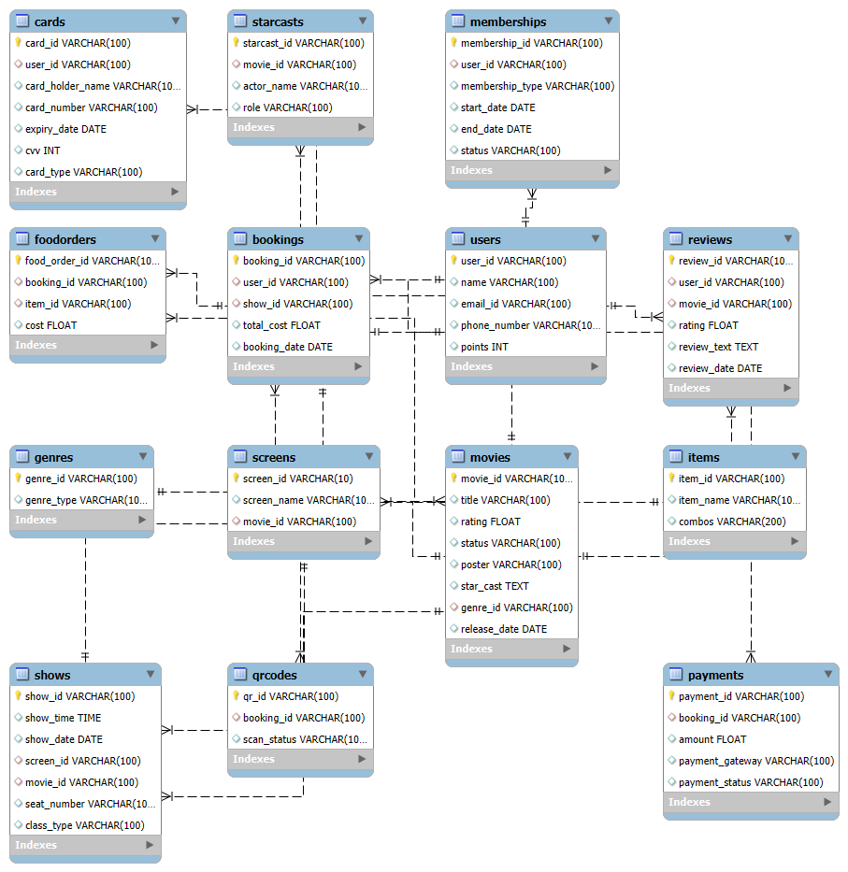
ER DIAGRAM

Slide 7

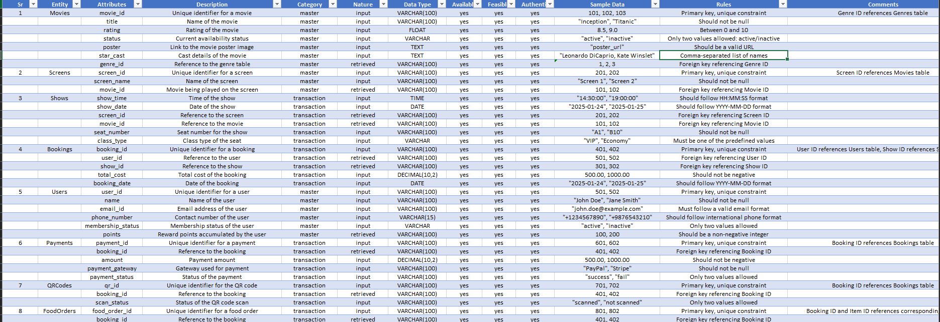
DATA DICTIONARY

Slide 8

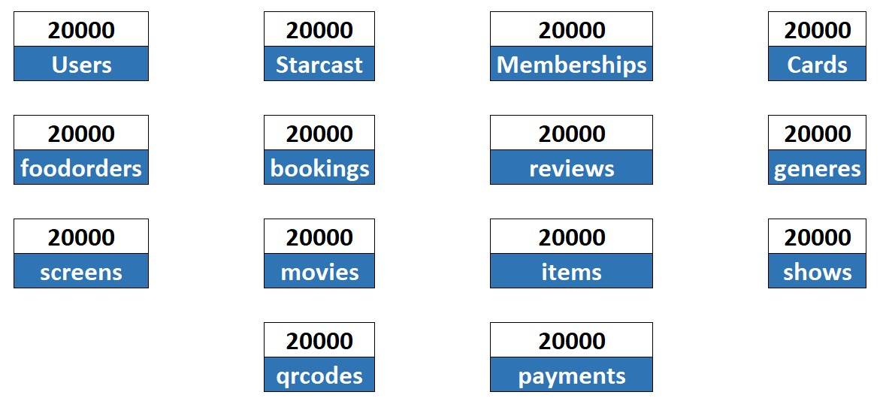
DATA GENERATION

Slide 9
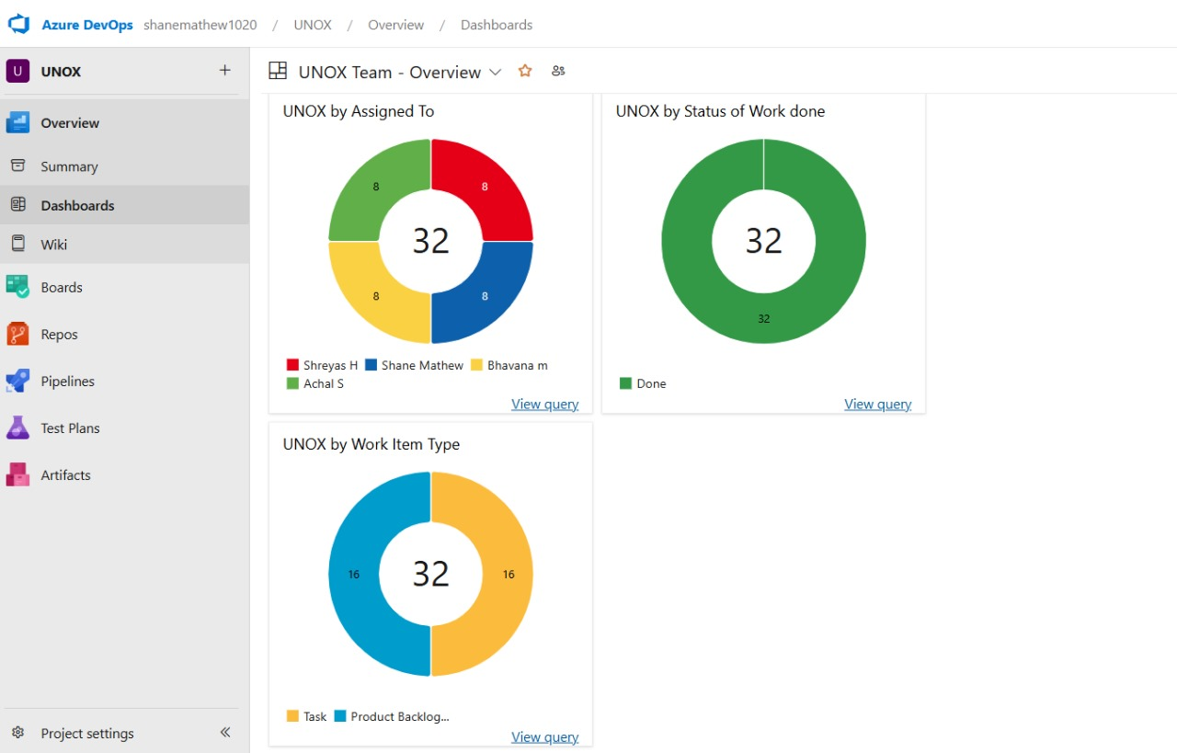
PRODUCT BACKLOG

Slide 10


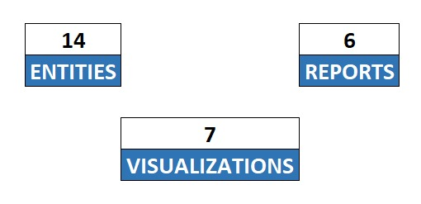
DATA ANALYTICS

Slide 11


THANK YOU

